Slide 1
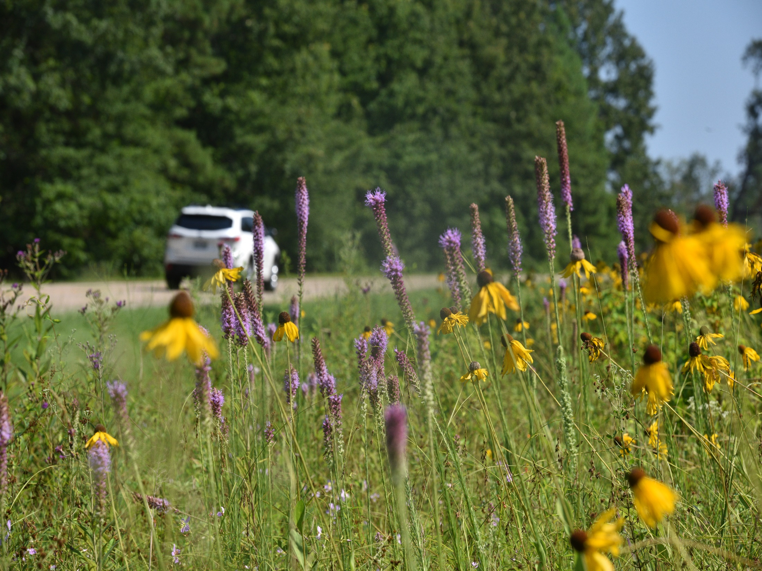
Collaborative Implementation of Integrated Roadside Vegetation Management Practices: Maintenance Mows for Monarchs!

Slide 2
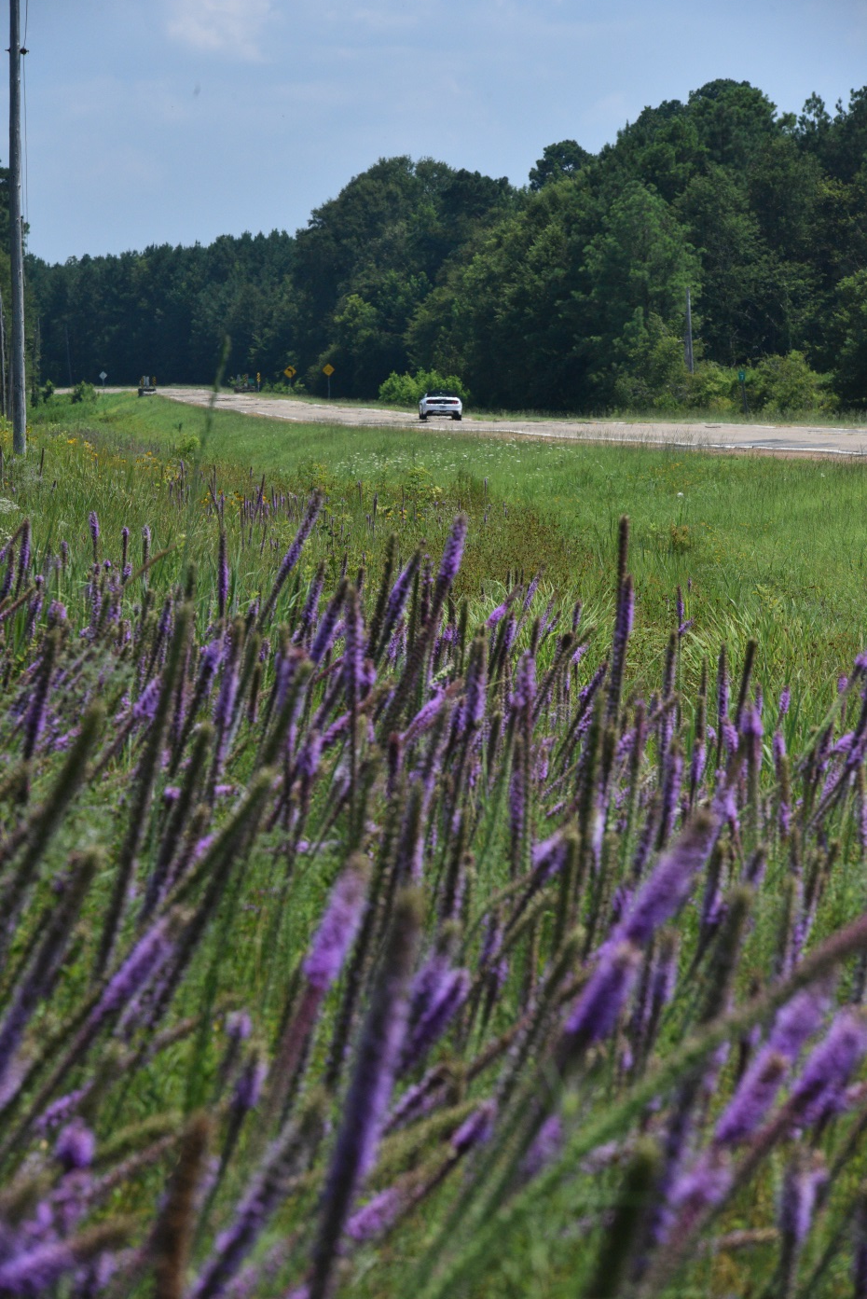

Function of Highway Rights-of-way:
Drains excess water from roadway
Provides safety
Provides location for public utilities
Provides aesthetic
Provides habitat for pollinators
ARKANSAS DEPARTMENT OF TRANSPORTATION
Notes:
The Arkansas Department of Transportation has approximately 200,000 acres of rights-of-way across the state. This land is adjacent to state and US highways in various forms, including ditches and medians between divided highways. Highway rights-of-way serve many important functions, including: drains excess water away from roads; serves as a safety feature for vehicles that leave the travel lanes; provides a location for public utilities (e.g., sewer, storm water, electric and communication lines); contains desirable vegetation that improve highway aesthetics and provide erosion control; And provides habitat for pollinators, nesting birds and other small wildlife.

Slide 3

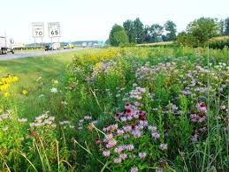
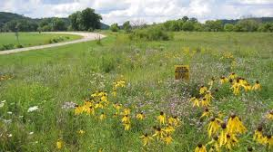
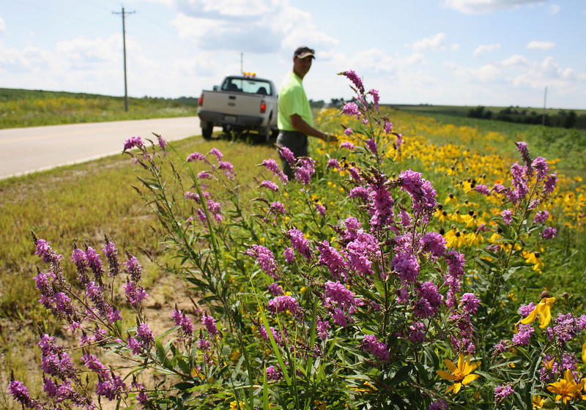
Integrated Roadside Vegetation Management
Integrated Roadside Vegetation Management (IRVM):
Establishes low-maintenance, native vegetation
Suppresses unwanted vegetation
Emphasizes prevention
Reduces maintenance costs
Reduced mowing and pesticide use
Most states must mow only to maintain a “clear zone.”
Plant low-growing vegetation within the clear zone to eliminate excessive mowing.
Notes:
For the past 50 years or more, mowing & herbicides have been the predominant methods used to control roadside vegetation on highway ROWs. New environmental laws, reduced budgets and increased public interests have facilitated finding more environmentally sensitive methods, new technologies, lower maintenance costs and cost-effective alternatives to today’s methods toward management of roadside vegetation. Integrated Roadside Vegetation Management or IRVM is one of those alternatives.
IRVM still utilizes mowing & herbicide application to manage roadside vegetation; however, it aims to establish & sustain native vegetation & to provide an aesthetically pleasing transportation system by reducing the amount of mowing and herbicide used. A well-timed mowing regime and selective herbicide application is also important for maintaing pollinator habitat, as it reduces woody vegetation and invasive species encroachment and disperses seed. Using IRVM practices, the ArDOT Environmental and Maintenance Divisions have come together to provide safe, aesthetically pleasing and functional transportation systems for the traveling public and pollinating insects.

Slide 4
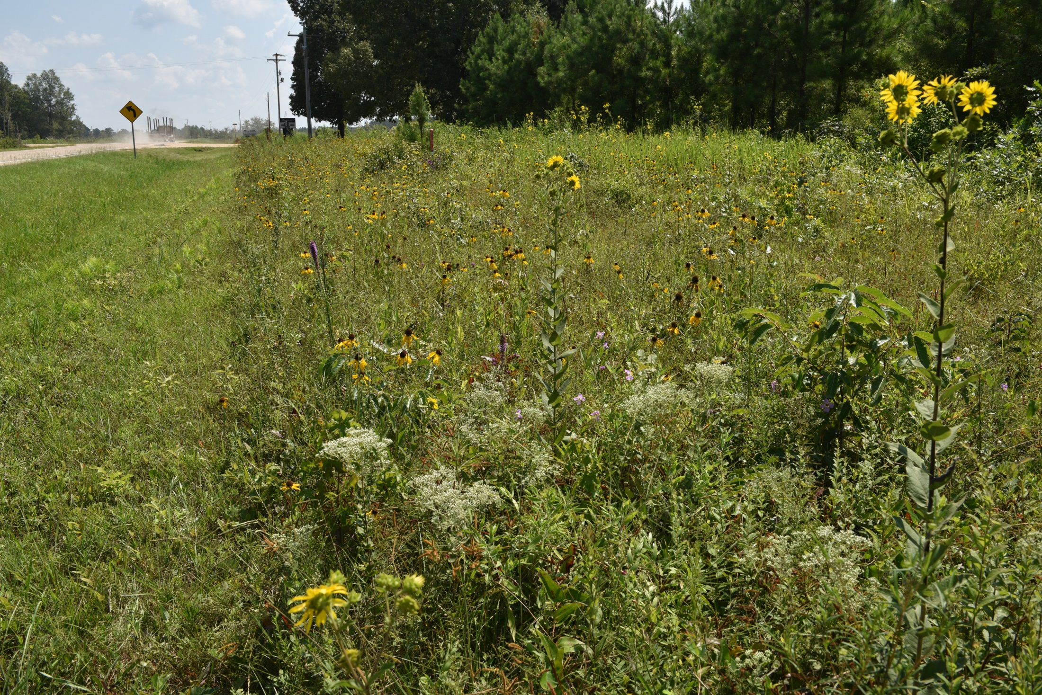
Mowing for Monarchs
Best Management Practices:
Avoid mowing the entire habitat.
Timing of mowing is critical.
Avoid mowing plants while in bloom and before they set seed.
Limit mowing to no more than twice per year.
Use a flushing bar and cut at reduced speeds.
Use a minimum cutting height of 8-12 inches.
Avoid mowing at night.
Notes:
The Monarch Joint Venture and the US Fish and Wildlife Service have outlined a series of Best Management Practices in their published handout, Mowing: Best Practices for Monarchs.
Avoid mowing the entire habitat to leave refuge areas for wildlife using the site at the time of mowing. This will allow for re-colonization of the mowed site by seed dispersal from the adjacent, un-mowed areas. Leave areas that may be good nesting sites for pollinators and other wildlife; for example, areas with accumulated leaf litter, dead stems and other ground cover OR areas with known host plants; for example, areas with large stands of milkweeds. Marking known areas may prevent accidental mowing.
Untimely mowing can result in high levels of insect mortality and habitat removal. Mowers can directly kill insect eggs, larvae, pupae and even adults; mowing also removes important landscape features that provide nectar and pollen resources, plant diversity and may impact nesting areas used by pollinators.
Avoid mowing during times of peak insect activity; this timing will vary between species. Avoid mowing plants while in bloom, and limit mowing to no more than twice per year.
We are going to take a more in-depth look at a few of these BMPs & how ArDOT has incorporated them into our maintenance practices.

Slide 5
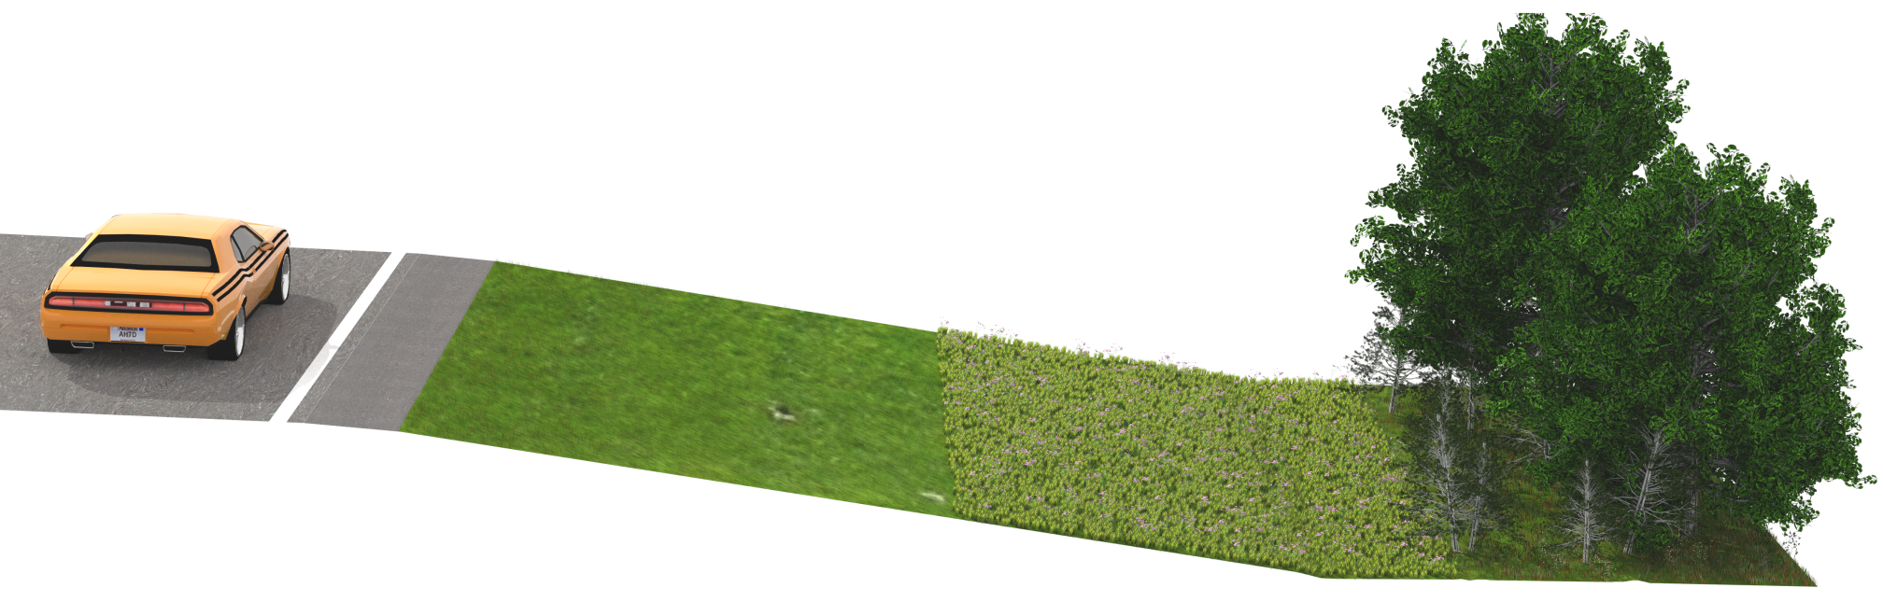
Integrated Roadside Vegetation Management
Clear Zone
Transition Zone
Natural Zone
Mowed 3x per year
Broadcast herbicide applications
Mowed once a year, in the fall
Spot-spray herbicide application of nonnative, invasive species
Where mature trees have become established
Notes:
At ArDOT, we are utilizing IRVM to reduce mowing to once a year on a large percentage of our transportation system, which has potential cost-saving benefits. We have divided our rights-of-way into three parts: the clear zone, the transition zone and the natural zone. The clear zone is mowed three times a year and broadcast application of herbicides is used prior to and between mowing cycles to maintain sight distances. The transition zone is mowed once a year and is where we want wildflowers to thrive. This is in line with the Avoid Mowing the entire habitat, Avoid mowing during peak insect activity and peak blooming period and limit mowing BMPs, due to the transition zone only being mowed once a year in the fall.

Slide 6
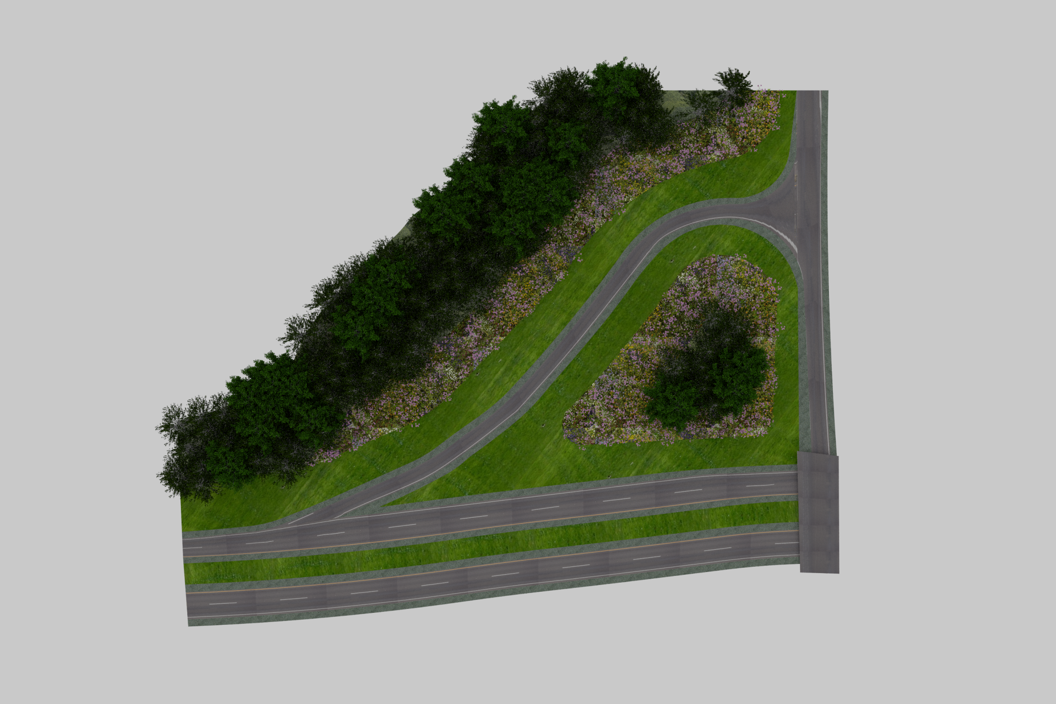
Natural Zone
Transition Zone
Clear Zone
ARKANSAS DEPARTMENT OF TRANSPORTATION
Notes:
These practices have been extended to the vegetation management within our interchanges as well. With some of our larger interchanges being around 30 acres in size, reducing mowing in these areas can drastically cut maintenance personnel time spent and costs.

Slide 7
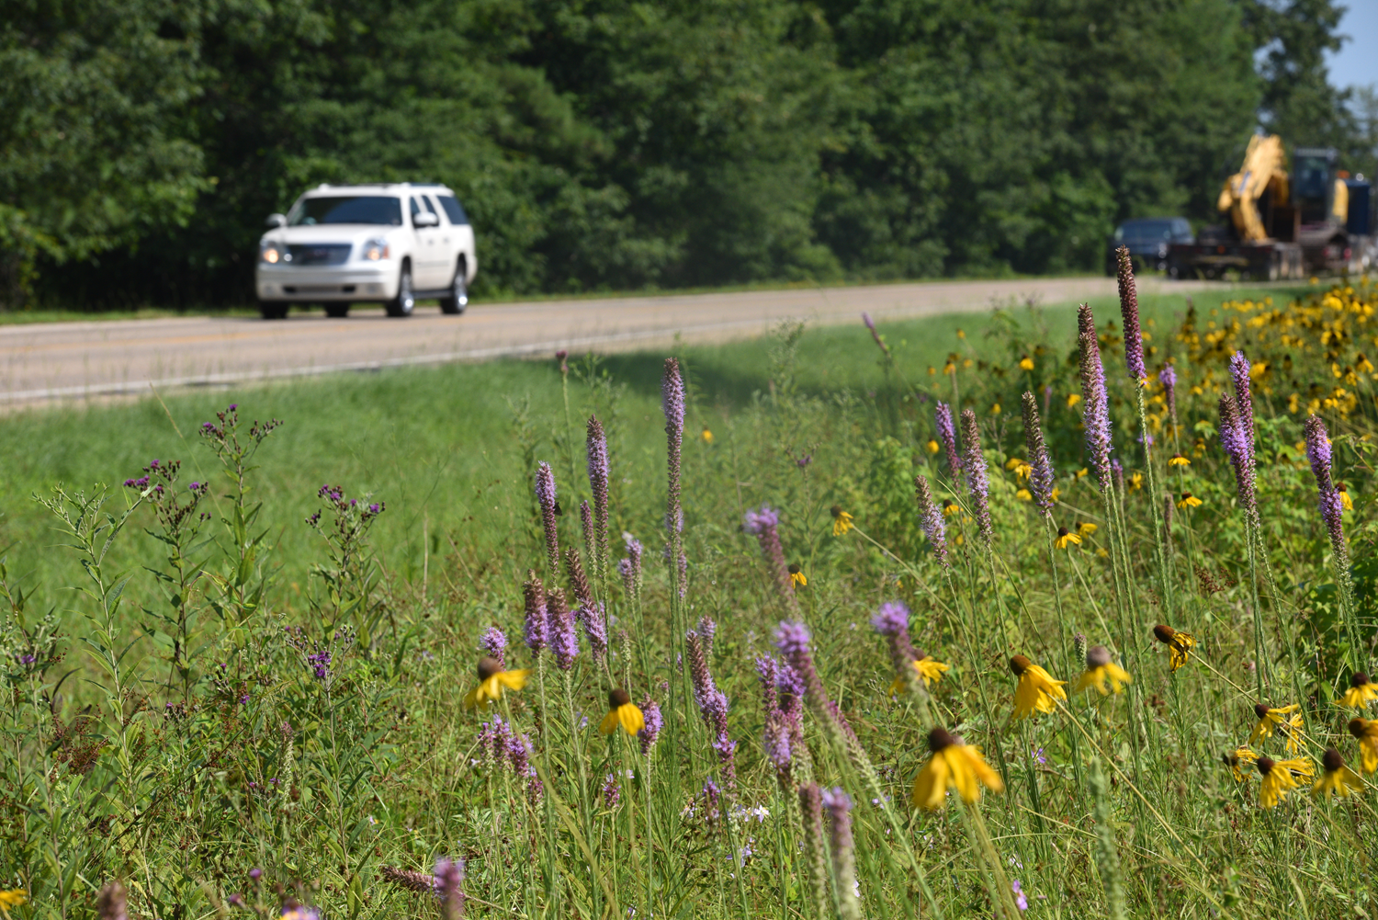
Highway 425 in Ashley County
Clear Zone
Transition Zone
ARKANSAS DEPARTMENT OF TRANSPORTATION
Notes:
This photo shows an established transition zone and a maintained clear zone on US Highway 425 in Ashley County. Highway 425 is one of ArDOT’s designated Wildflower Routes, from south of Star City to the Louisiana line.

Slide 8
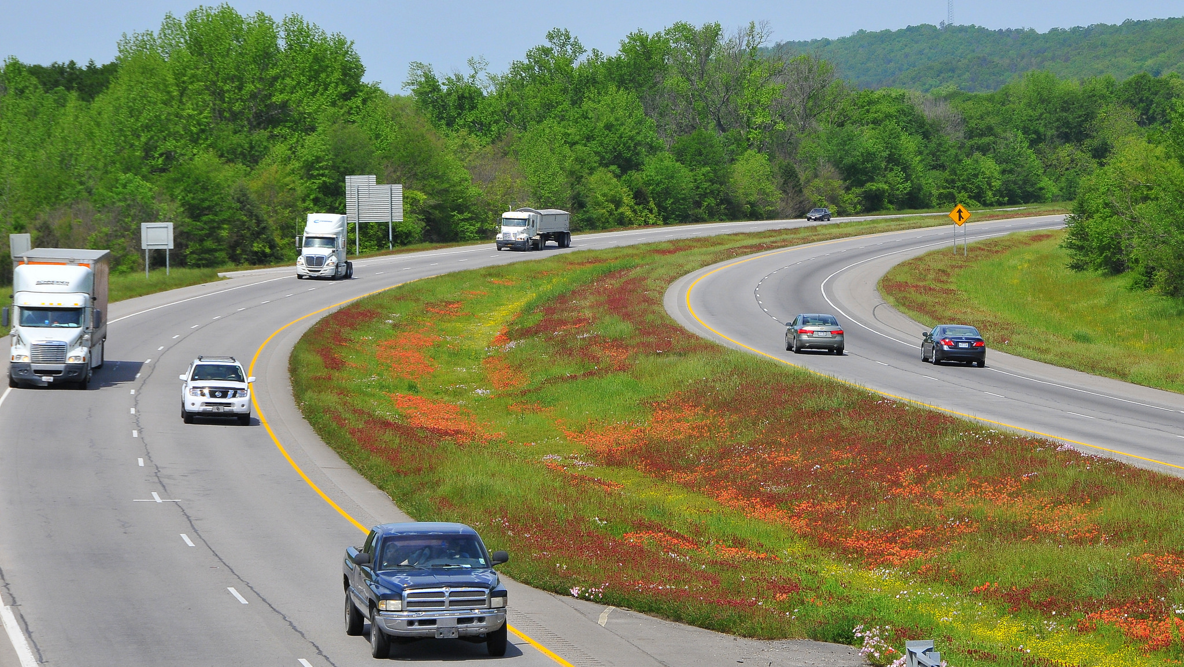
ARKANSAS DEPARTMENT OF TRANSPORTATION
Notes:
Typically, medians of divided highways and interstates are included in the Clear Zone, and are mowed 3x a year and broadcast spraying is utilized to manage vegetation. In District 8, they are very proud of their large showy, stands of Indian paintbrush, crimson clover, and showy evening primrose in April and May. This 3- to 4-mile stretch of I-40 near Ozark is managed by delaying the first mowing cycle and limiting herbicide use to proliferate these wildflowers.

Slide 9
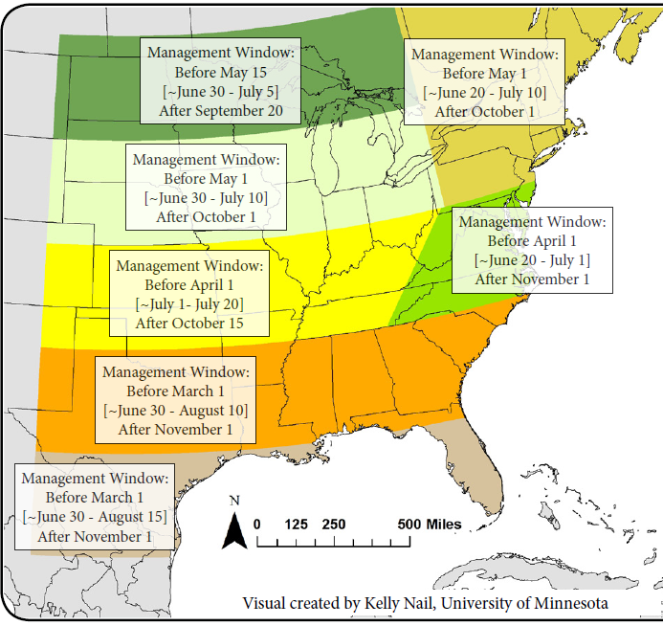
Mowing for Monarchs
Notes:
It has been established that reduced and well-timed mowing regimes are vital to maintaining pollinator habitat along roadsides. So when is the correct time to mow? As a rule of thumb, avoid mowing during peak flowering times and peak pollinator activity. Fortunately for us, these are not mutually exclusive as peak pollinator activity will correlate with peak flowering times. During March-April, Monarchs are passing through Arkansas as they journey north, and in September-October, Monarchs are in Arkansas as they make their journey south to overwintering sites in Mexico. The central purpose of providing pollinator habitat is so pollinators have abundant floral resources throughout the growing season and during both north and south migrations.
To summarize this figure, in Arkansas, the best mowing management windows include: the 1st mowing to take place before March 1 in southern Arkansas and before April 1st in northern Arkansas. Unfortunately, here there isn’t much vegetation to mow so early in the year. ArDOT’s first mowing cycle is from April 1st in southern Arkansas, April 15th in central Arkansas, and May 1st in northern Arkansas. While this mowing cycle timeline seems to conflict with the above map, if we are only mowing the clear zone during this time, then we are providing pollinator habitat and refuge in the transition zone. In fact, by keeping the clear zone mowed, perhaps we are providing a buffer between pollinators and vehicles and actually reducing mortality.
ArDOT’s 2nd mowing cycle, if needed, begins June 15th in southern Arkansas, July 1st in central Arkansas and July 15th in northern Arkansas. This mowing cycle does match up with the above timeline, and some Districts want to their full-width mow during the 2nd mowing cycle versus the fall mowing cycle due to the roadside being too wet in November. Most monarchs are north of Arkansas in July, but some do hang around, so pollinator mortality can occur but it is low. However, mowing down patches of wildflowers in July does not bode well for supply of nectar resources during the monarchs’ fall migration.
ArDOT’s 3rd mowing is typically a full-width mow and can begin on October 1st and has to be finished by Thanksgiving. A full-width mow in fall includes the transition zone, which is ideal since the flowers have set seed and mowing will distribute the wildflower seeds and replenish the seed bank for next year. Ideally, we would push back the start date on the fall mowing cycle and provide different mowing windows for different parts of the state, like we see with the first two mowing cycles. Delaying the final clean-up mow until after the first frost mimics natural weather regimes and processes and can provide season long blooms the following year.
But, as it was mentioned earlier, we have about 200,000 acres to mow across the state, and Maintenance personnel is already strapped for time, so we can’t always abide by these recommended times. It’s our goal, that by establishing transition zones, we can adhere to these dates more often than not.

Slide 10
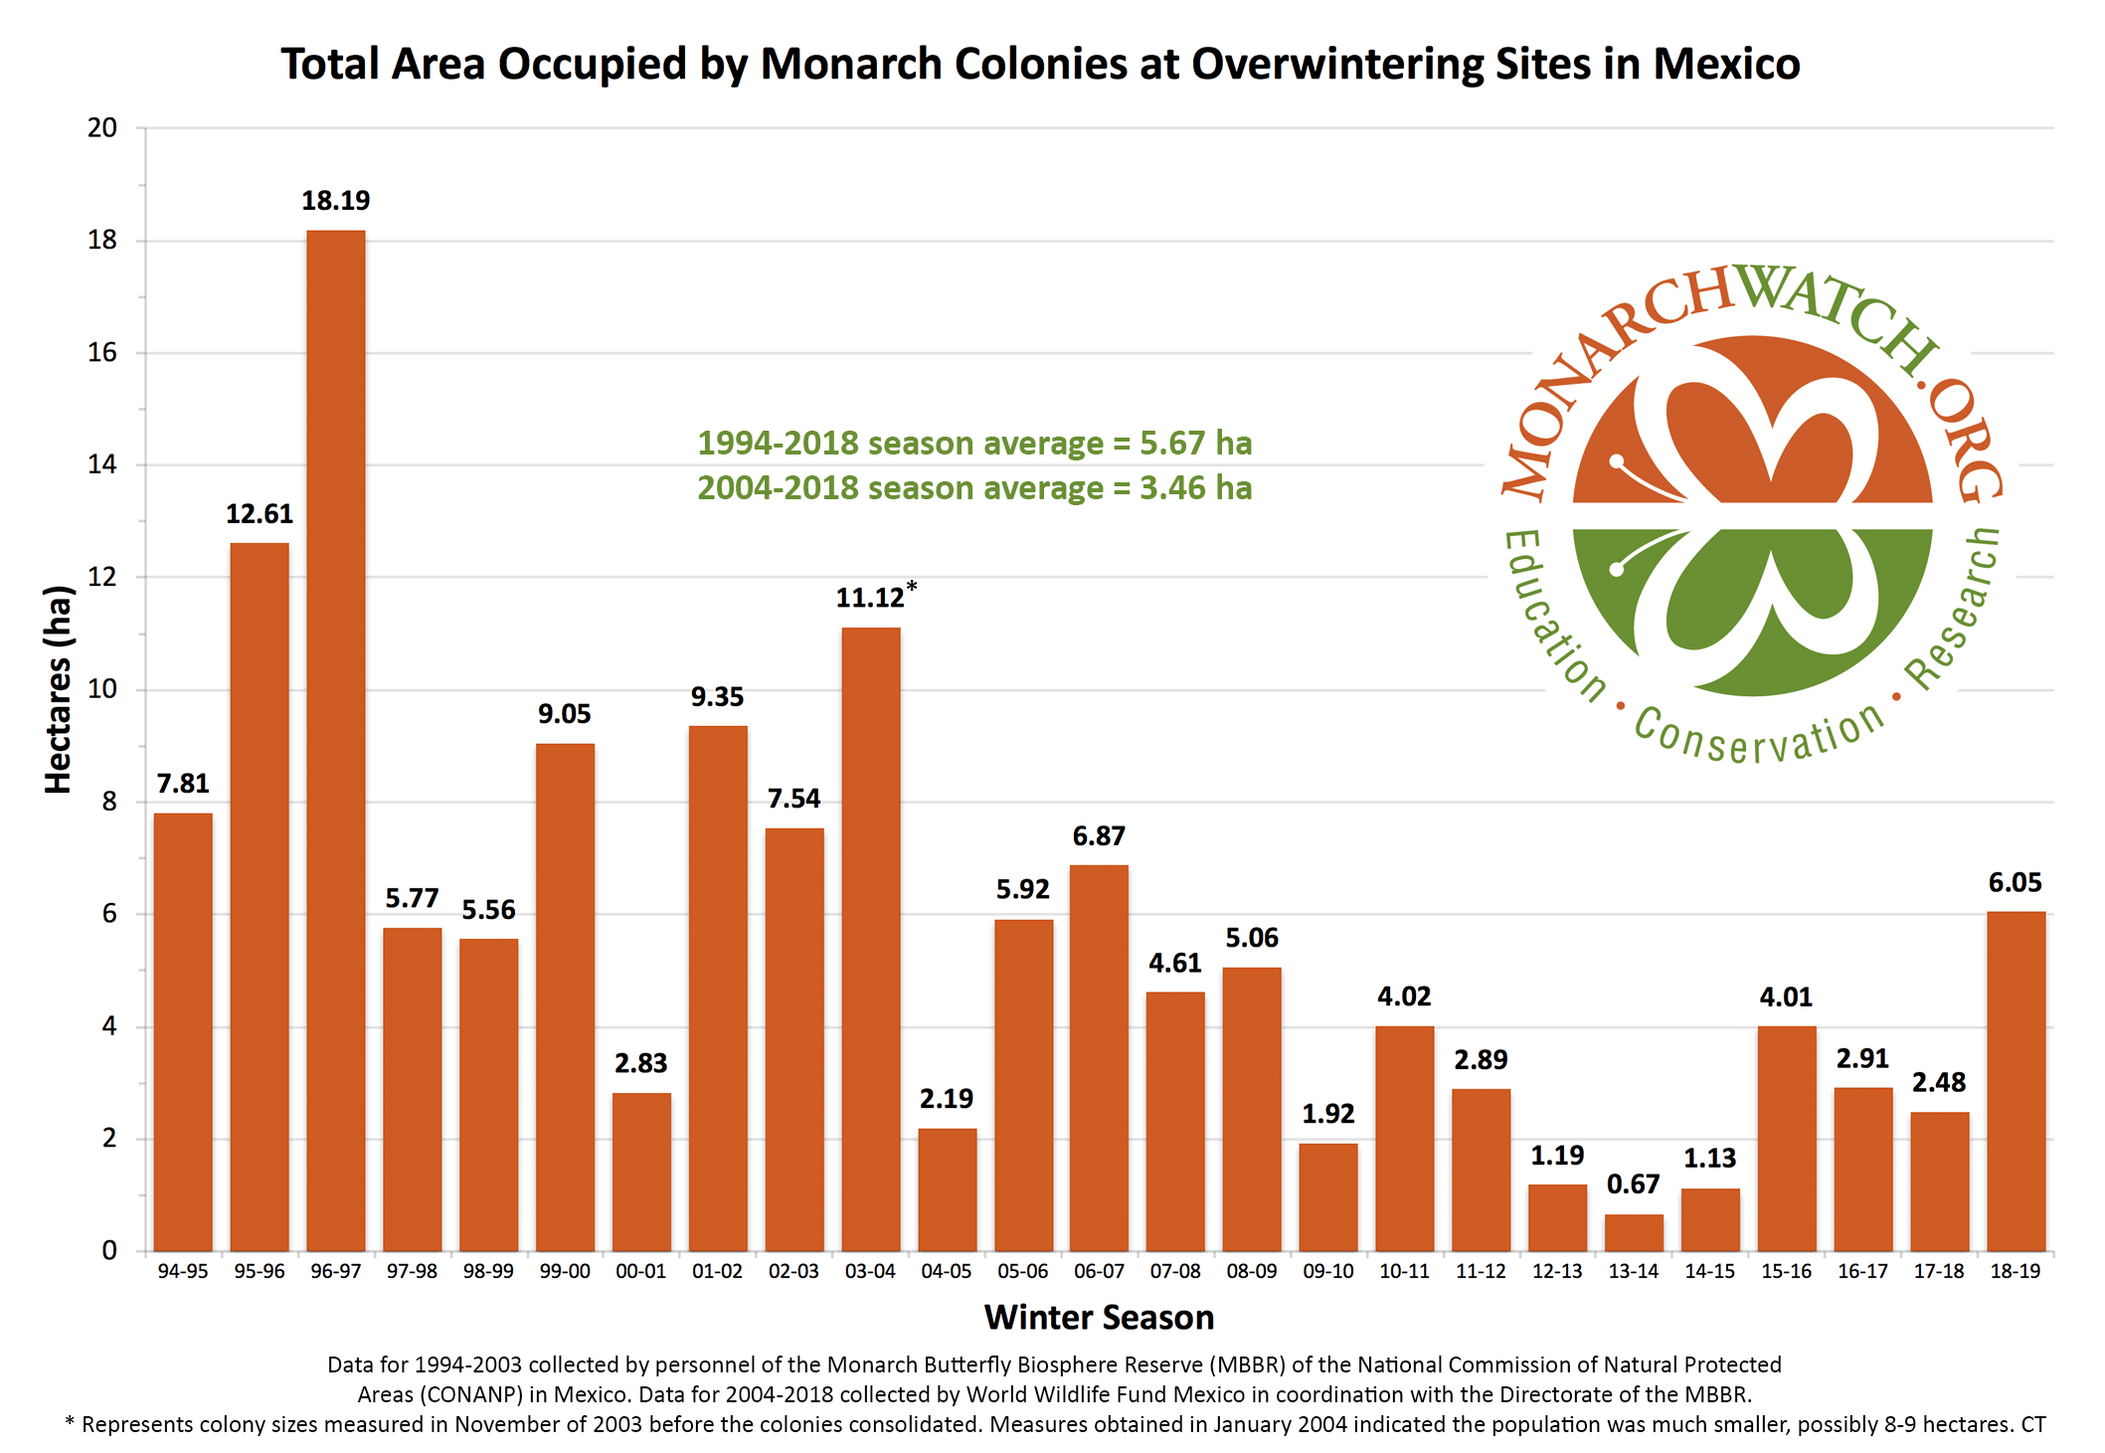
ARKANSAS DEPARTMENT OF TRANSPORTATION
Notes:
Why mow for monarchs? The number of overwintering monarchs in Mexico’s forests has declined by 90% or more over the past two decades, placing the iconic annual North American Monarch migration at risk. This graph shows the estimated numbers of the eastern Monarch population at their overwintering sites in Mexico.
The Monarch population is estimated not by counting number of individuals, but by calculating the number of hectares they cover while overwintering. Monarchs cluster together to stay warm, and tens of thousands can cluster on a single tree.
Last year, the monarch butterflies hibernating in Mexico made a rebound! It’s too early to know if these new figures were a blip; insect populations are very susceptible to ups and downs in population numbers.

Slide 11
ARDOT’s Wildflower Programs
Operation Wildflower
Wildflower Signage Program
  “Wildflower Area Sponsored by ________” sign.
Wildflower Routes
Native Wildflower Area Signage Program
Wildflower Seeding Specifications
Notes:
Timely mowing regimes and selective herbicide applications, such as those outlined in IRVM practices, help to facilitate, establish and maintain our several wildflower programs as well.
Wildflowers that provide nectar are critical for adult butterflies. Together with milkweed, this habitat provides monarchs with breeding resources, resting and refueling stops during migration, as well as nourishment to survive overwintering. Diverse habitat filled with wildflowers and milkweed supports not only monarchs but also our native bees and other pollinators.
Our wildflower programs help establish new pollinator habitat on the ground and preserve existing pollinator habitat.

Slide 12
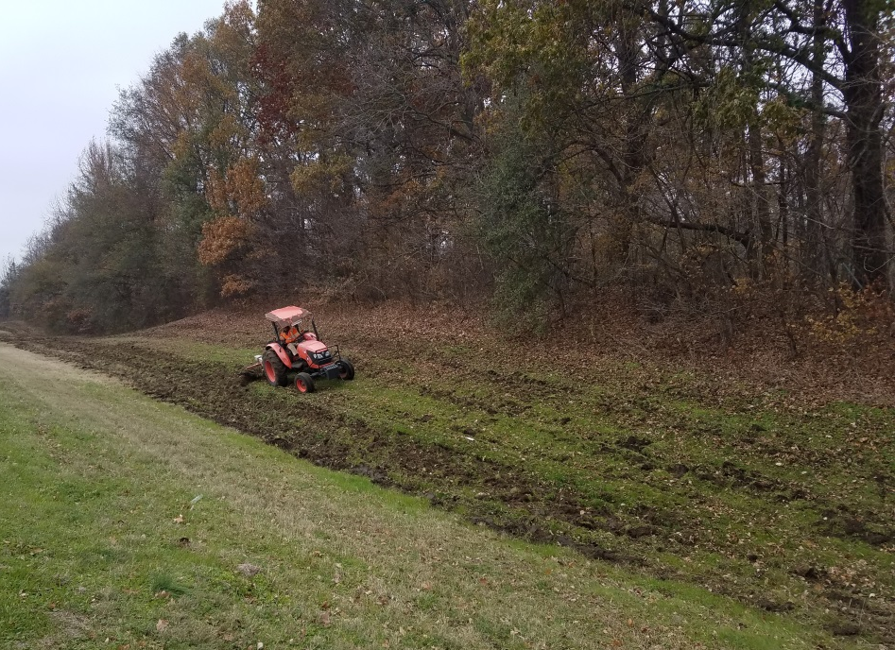
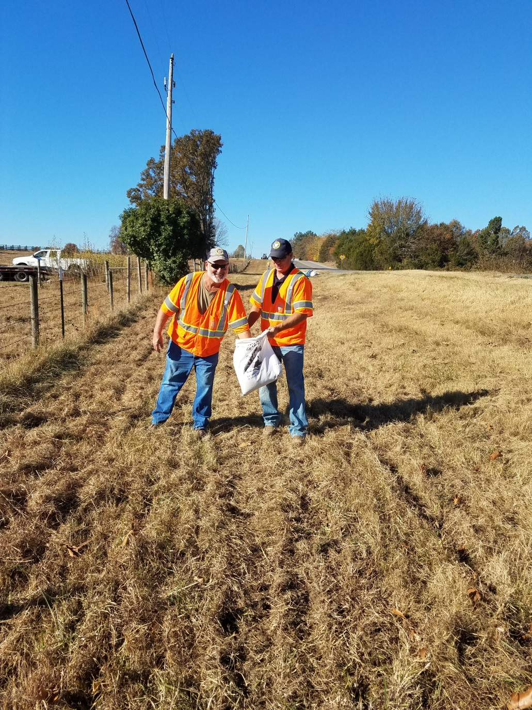
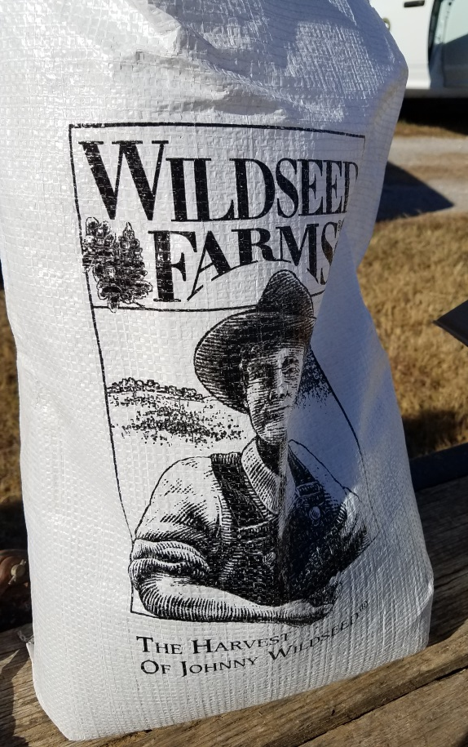
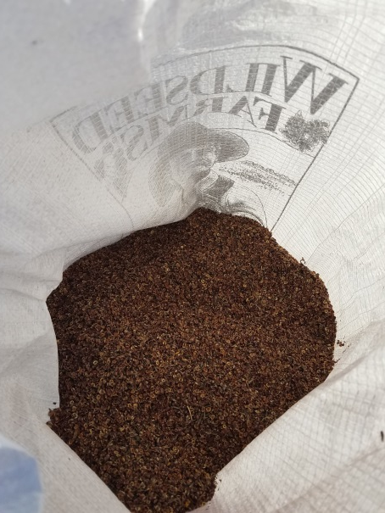
Operation Wildflower Program
Notes:
In ArDOT’s Operation Wildflower Program, District maintenance crews plant wildflower seeds donated by local group and individuals on highway rights-of-way. The top left image, shows District 1 maintenance personnel disking an Operation Wildflower site near Helena-West Helena. The top right image shows District 5 maintenance personnel seeding a stretch of Highway 58, in which wildflower seeds were donated by our very own District 5 Engineer, Mr. Bruce Street.
Areas with wide rights-of-way, new construction, and along National and State Scenic Highways are great choices for wildflower plantings because of the high visibility factor from local and visiting motorists. In these areas, mowing (outside the clear zone) is reduced to once a year in the fall. Operation Wildflower Projects are maintained by an annual mowing in the fall, once the flowers have set seed, and continually re-seed the area.

Slide 13
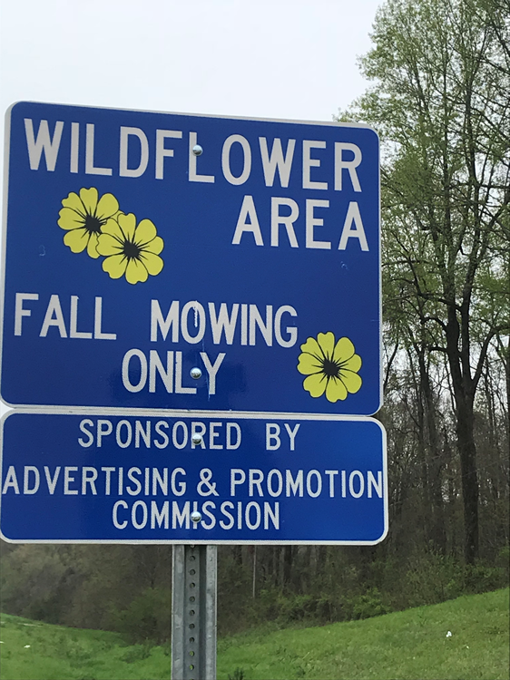
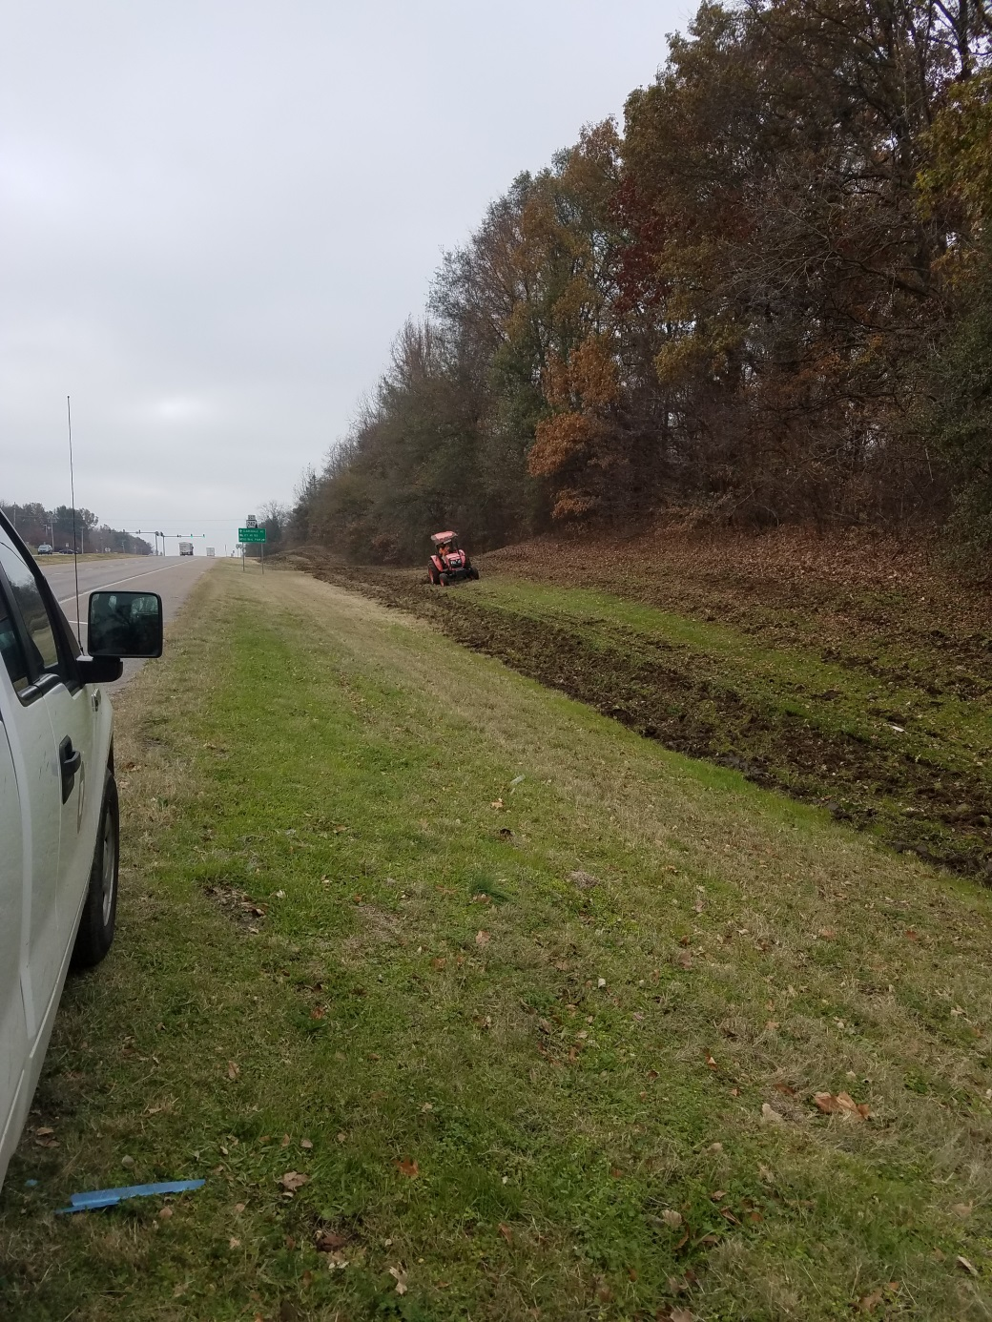
Wildflower Signage Program
Notes:
Sponsors of Operation Wildflower Projects that donate a significant amount of wildflower seed are recognized with a “Wildflower Area Sponsored by _____________” sign. In the above example, the Helena-West Helena Advertising and Promotion Commission donated $1700 worth of native wildflower and grass seed to be planted along Highway 49 in Phillips County.
This also directly ties into one of the Best Management Practices for pollinator conservation by providing signage to eliminate accidental mowings.

Slide 14
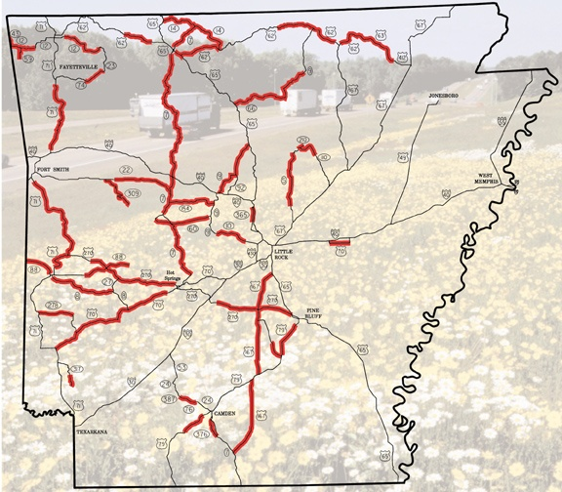
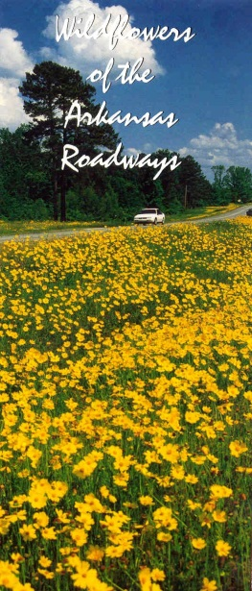
ArDOT’s Wildflower Routes
Highway 425 in Ashley County
Notes:
ArDOT has approximately 1,000 miles of highway designated as Wildflower Routes across the state that are managed to sustain wildflower populations. Broadcast spraying is not allowed on Wildflower Routes outside of spot spraying for nonnative, invasive species. The Department’s Wildflower Brochure, Wildflowers of the Arkansas Roadways, includes a map of ArDOT’s Wildflower Routes. Over 1,000 miles of state and US highways have been designated as Wildflower Routes based on the presence of naturally occurring wildflower populations.
And we are very excited that currently, the Environmental Division is working with ArDOT’s photographer, Rusty Hubbard, and graphic designer, Paula Cigainero to redo our wildflower brochure!

Slide 15
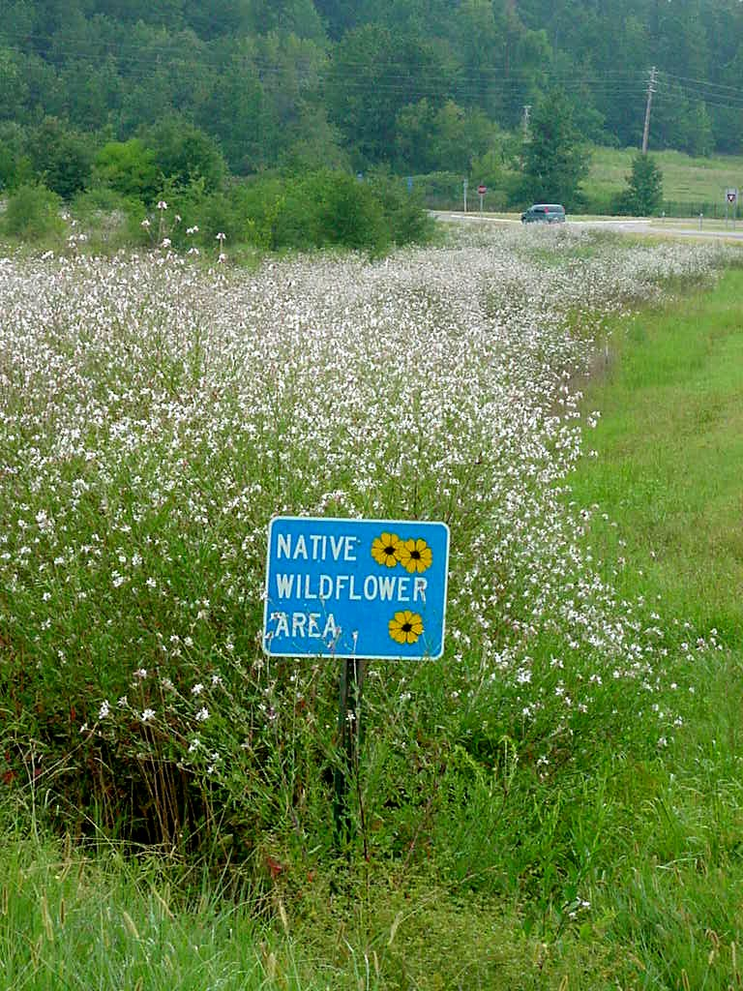
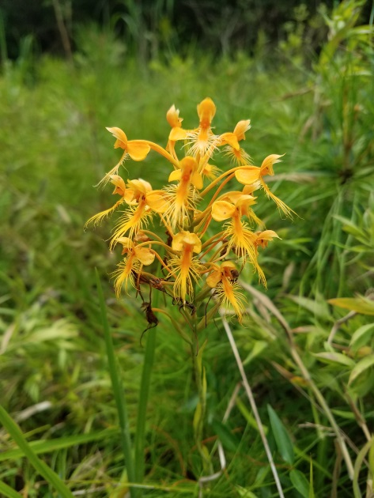
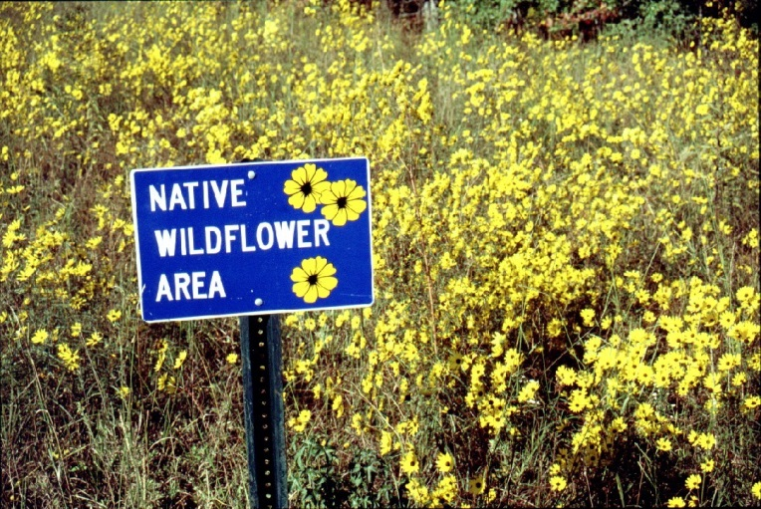
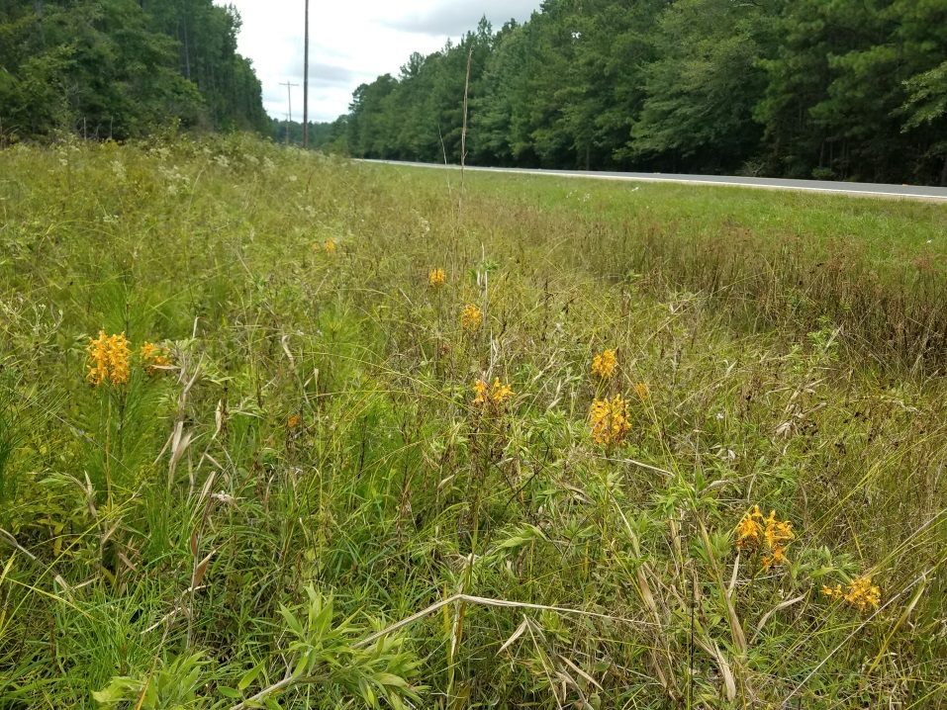
Native Wildflower Area Signage Program
I-430
Highway 8
Notes:
Native Wildflower Area signs are installed to raise public awareness of naturally occurring wildflower populations on highway rights-of-way. We encourage the public to inform us of large, showy stands of naturally occurring wildflowers along our highways. We work closely with the Arkansas Native Plant Society, and most recently the Arkansas Native Plant Society alerted us to a sizeable stand of yellow fringed orchids (Platanthera ciliaris) on Highway 8 in Cleveland County. In these Native Wildflower Areas, spot spraying of invasive species is allowed, while broadcast spraying is prohibited and a once-a-year fall mowing is used to re-seed the area.

Slide 16
Standard Wildflower Seeding Specification
Species | Lbs/acre
Blackeyed Susan (Rudbeckia hirta) | 0.5
Lanceleaf coreopsis (Coreopsis lanceolata) | 1.0
Purple blazingstar (Liatris pycnostachya) | 0.5
Purple coneflower (Echinacea purpurea) | 0.5
Showy evening primrose (Oenothera speciosa) | 0.5
Tickseed coreopsis (Coreopsis tinctoria) | 1.0
Notes:
ArDOT’s construction projects help to put pollinator habitat on the ground as well. After every highway construction project, these six native wildflowers are sown at a rate of 4 pounds per acre per our Standard Seeding Specification. Native seed mixes for roadside plantings should include a number of wildflowers with overlapping bloom times, so pollinators will have a continuous source of food and the roadside will be attractive throughout the growing season. And ArDOT’s wildflower mix accomplishes just that—we have the showy evening primrose blooming in April to May, sometimes as early as March, and the purple blazing star blooming in August to September, while the others are blooming in between.

Slide 17
Special Wildflower Seeding Specification
Species | Lbs/acre
Big bluestem (Andropogon gerardii) | 1.5
Little bluestem (Schizachyrium scoparium) | 7
Indian grass (Sorghastrum nutans) | 1.5
Cereal rye (Secale cereale) as a cover crop | 100
Lanceleaf coreopsis (Coreopsis lanceolata) | 4
Blackeyed Susan (Rudbeckia hirta) | 0.5
Purple blazingstar (Liatris pycnostachya) | 3
Partridge pea (Chamaecrista fasisculata) | 3
Butterfly milkweed (Asclepias tuberosa) | 2
Pale purple coneflower (Echinacea pallida) | 2
Wild bergamont (Monarda fistulosa) | 1
Notes:
Highway construction projects involving federal and state lands; National Forests and National Parks and State Parks, include a Special Provision in the job contract that directs the sowing of a native seed mix, which includes three native grasses and seven native wildflowers, including one milkweed species! Once native plants are established, they require less maintenance, water and fertilizer than nonnatives, and native vegetation on roadsides resist invasion by nonnatives and provide excellent pollinator and wildlife habitat.
Recently, we have also been coordinating with construction about a special provision to maintain wildflowers when a highway project is scheduled on a designated wildflower route. Specifically the scheduled/ongoing widening of Highway 425, south of Hamburg to the Louisiana line, we included a special provision to save and reuse topsoil on the job, so that the seed bank would remain intact.

Slide 18
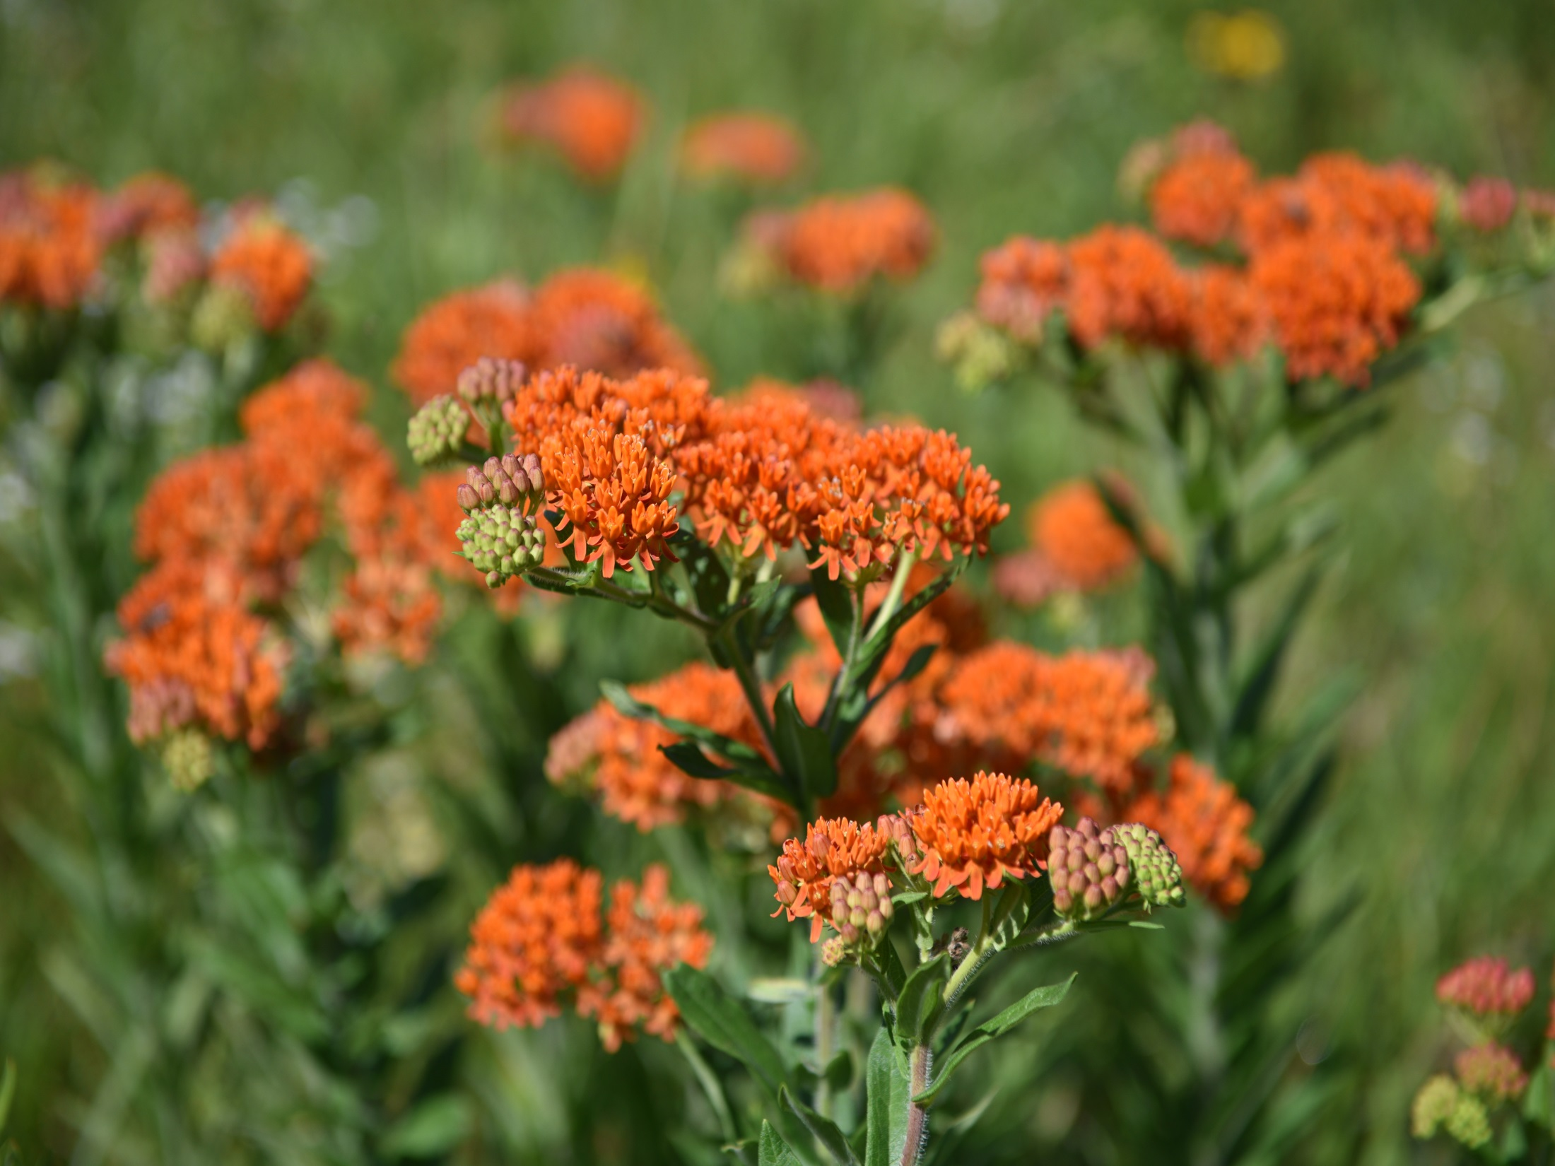
District Wildflower Plots
Notes:
District 3 - On I-30, from Fulton to Hope, the transition zone had become overgrown with weedy, woody vegetation. This vegetation was removed and mulched on site. District 3 is patiently waiting to see what wildflowers come up naturally. If nothing, then we will implement wildflower plantings along I-30, outside of the clear zone. District 3 has also started to clear some brush along roadsides near the Red River Welcome Center in Miller Co.
District 9 - The city of Mtn. Home wanted the Department to mow more frequently along the Highway 412 bypass within Mtn. Home proper. ArDOT countered with planting wildflowers and an annual fall mowing.
In the Highway 412/Highway 5 Interchange, the brush was removed and burned on site. Obviously, burning vegetation on site, along highways, is not always practical, but it is a great way to restore nutrients to the soil, such as nitrogen. In the fall of 2017, wildflowers were planted within this interchange. District 9 also planted a 13-acre interchange near Huntsville. Ultimately, District 9 planted around 27 acres in wildflowers in 2017.
District 2 – On I-530, from White Hall to Hwy. 104, the transition zone was opened up by removing and mulching the scrub brush that had encroached in the transition zone. The brush clearing along I-530 really opened up areas in the right-of-way for more wildflowers.
District 8 – The I-40 interchange in Morrilton was planted in the fall of 2017.
District 8 and District 6 selectively cleared brush from several interchanges to open up the areas for wildflowers.

Slide 19
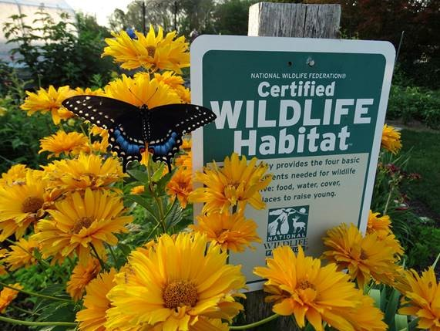
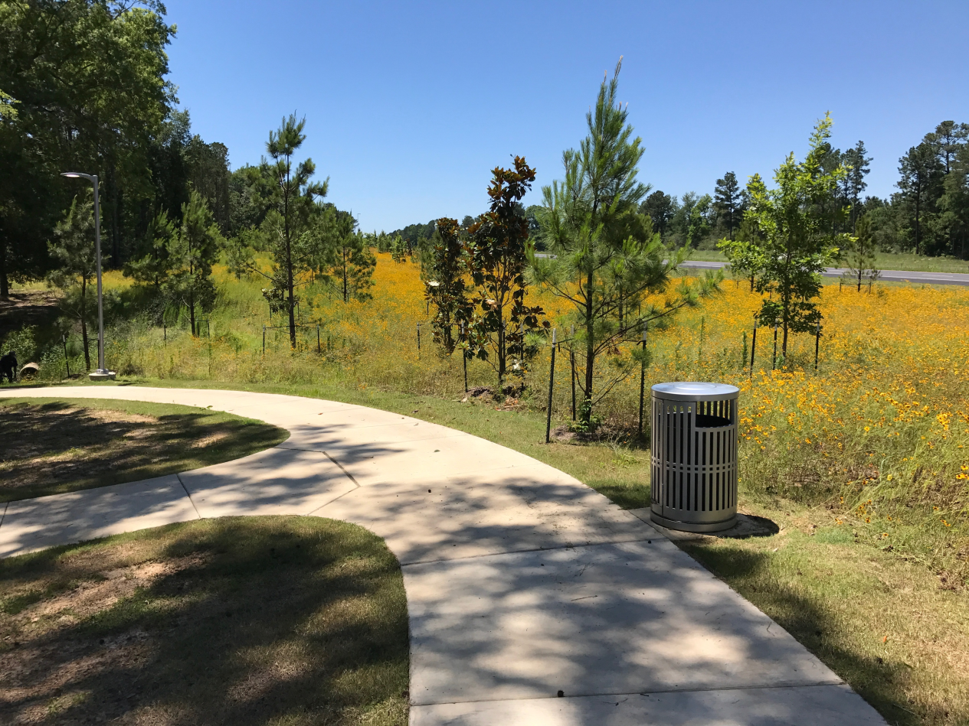
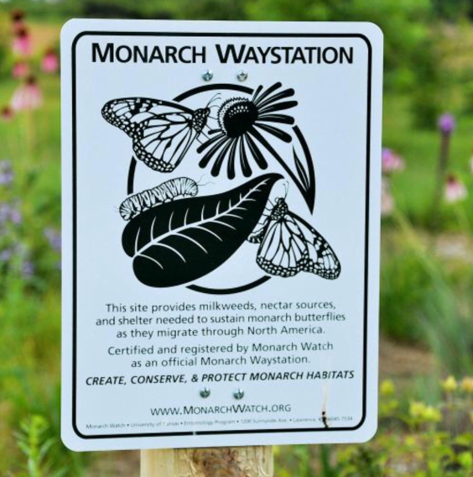
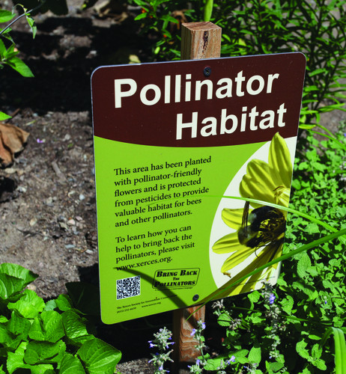
ARDOT’s Transportation Alternatives Program
Incorporating wildflower plantings into project proposals provides pollinator habitat too!
Use native plants with various bloom times
Include milkweeds, which are host plants for Monarchs
Notes:
ArDOT is also encouraging the use native plants in our Transportation Alternatives Program. Native plants are better adapted to the local climates and can provide excellent pollinator habitat in urban areas that may otherwise be devoid of such habitat. Planting pollinator habitat is an eligible activity for TAP funding.
For example, the following would be considered Eligible Project Activities:
Plant milkweeds and other nectar plants along existing Razorback Greenway corridor.
Incorporate planting of milkweeds and other nectar sources into future trail projects funded through TAP
Adding a landscaping element to a project could strengthen one’s chances of being funded since it would benefit two or more of the eligible TE activities.

Slide 20
Clear Zone
Transition Zone
ARKANSAS DEPARTMENT OF TRANSPORTATION
Notes:
By establishing clear zones and transition zones statewide, we are providing pollinator habitat during most of the growing season and following the best management practices that have been identified for pollinators and their habitat. We are able to avoid mowing pollinator habitat in its entirety, during peak insect activity and blooming periods by establishing transition zones. We are limiting mowing to only once a year, in the fall, to leave native plants in bloom longer while dispersing mature seed in the fall.

Slide 21
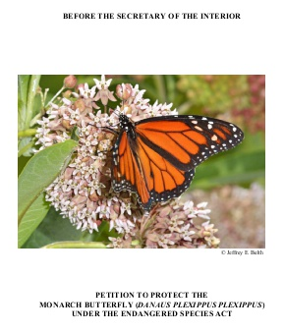
Candidate Conservation Agreement with Assurances
Notes:
In addition to the number of benefits planting native wildflowers along highway rights-of-way the Department can receive, from improving roadside aesthetic and cutting maintenance costs from reduced mowing, there is another benefit to the Department. In August of 2014, a petition to list the Monarch butterfly as a federally listed species was submitted to the US Fish and Wildlife Service. While the Service is currently reviewing this petition, several states, including other DOTs, have begun to formalize commitments to providing pollinator habitat along rights-of-way through Candidate Conservation Agreements with Assurances. Candidate Conservation Agreements with Assurances are formal, voluntary agreements between the US Fish and Wildlife and non-federal landowners to address the conservation needs of candidate species or species likely to become candidates.
Participants receive assurances that they will not be required to implement additional conservation measures beyond those in the CCAA. So what are the proposed conservation measures? Well, everything we’ve talked about today—reduced mowing and herbicide use, implementing wildflower plantings to improve and create pollinator habitat, all while maintaining pollinator habitat in the transition zone year-round by mowing only once in the fall. What this means for ArDOT is that if the monarch butterfly is ever listed as a federally threatened or endangered species, maintenance will not be required to do any additional consultation or conservation efforts.

Slide 22
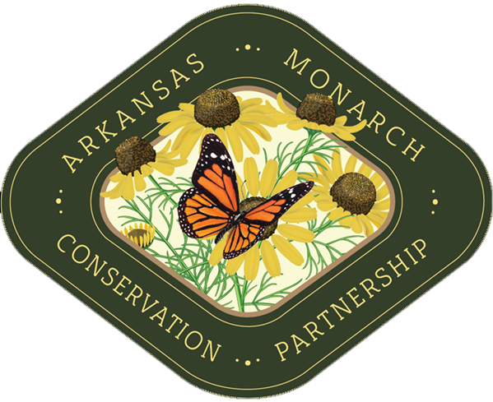
Arkansas Monarch Conservation Partnership
Visit our website at arkansasmonarchs.org for more information!
Notes:
The Arkansas Department of Transportation is a standing and dedicated committee member to the Arkansas Monarch Conservation Partnership. We were featured in a short film about Monarch Conservation for state initiatives, and we had an amazing turnout to last year’s Monarch and Pollinator Summit. You can visit arkansasmonarchs.org to find pollinator-friendly plant list, best management practices, and to find out about upcoming events.

Slide 23
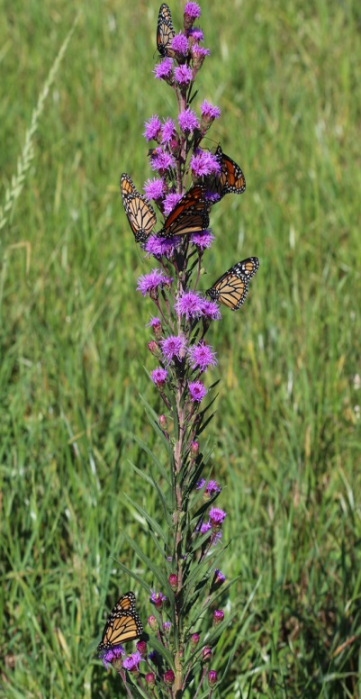
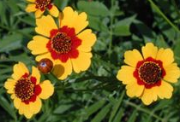
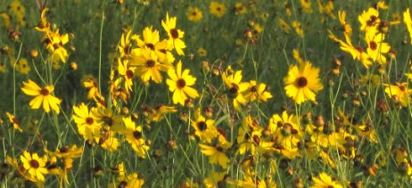
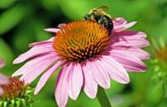
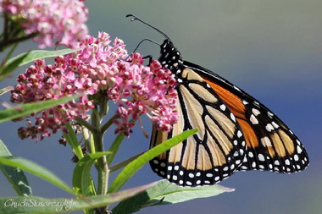
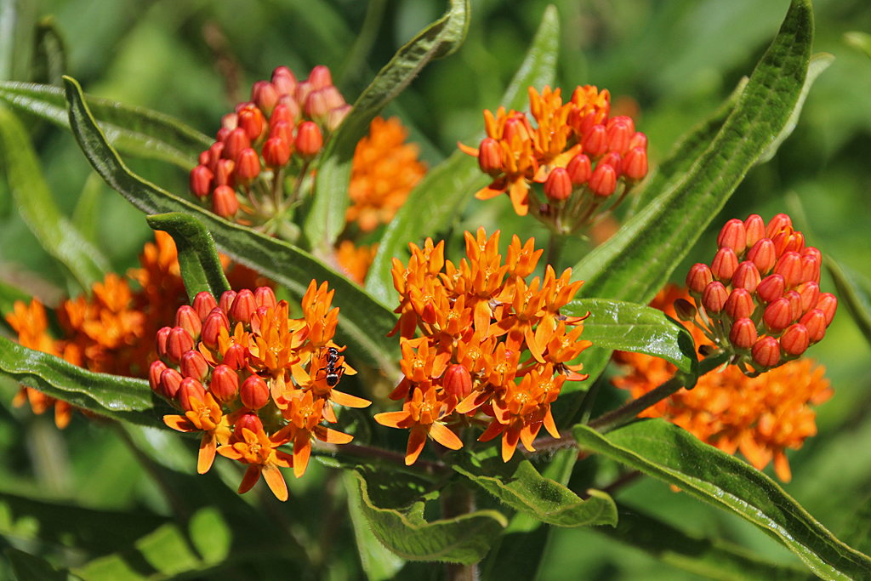
Arkansas Monarch Conservation Partnership
ArDOT’s EFFORTS
ArDOT adopted IRVM practices
  Clear zone
  Transition zone
  Natural zone
ArDOT’s Wildflower Seed Mix
ArDOT’s Wildflower Programs
  Operation Wildflower
  Wildflower Routes
  Native Wildflower Area Signage Program
ArDOT’s Candidate Conservation Agreement with Assurances
Notes:
In summary, ArDOT has adopted IRVM techniques to preserve and maintain native vegetation in order to provide pollinator habitat. Some 13,000 miles statewide incorporate IRVM practices, minus the Good Neighbor Policy—we mow adjacent to front yards.
ArDOT incorporates a native seed mix into every highway construction contract.
ArDOT’s ongoing wildflower programs add several wildflower sites along our roadsides each year. For example, we have five Operation Wildflower Projects scheduled for this year.
Currently, Environmental and Maintenance Divisions are working on formalizing our roadside vegetation management plan to ensure our maintenance activities are covered if the monarch butterfly ever becomes federally listed.

Slide 24
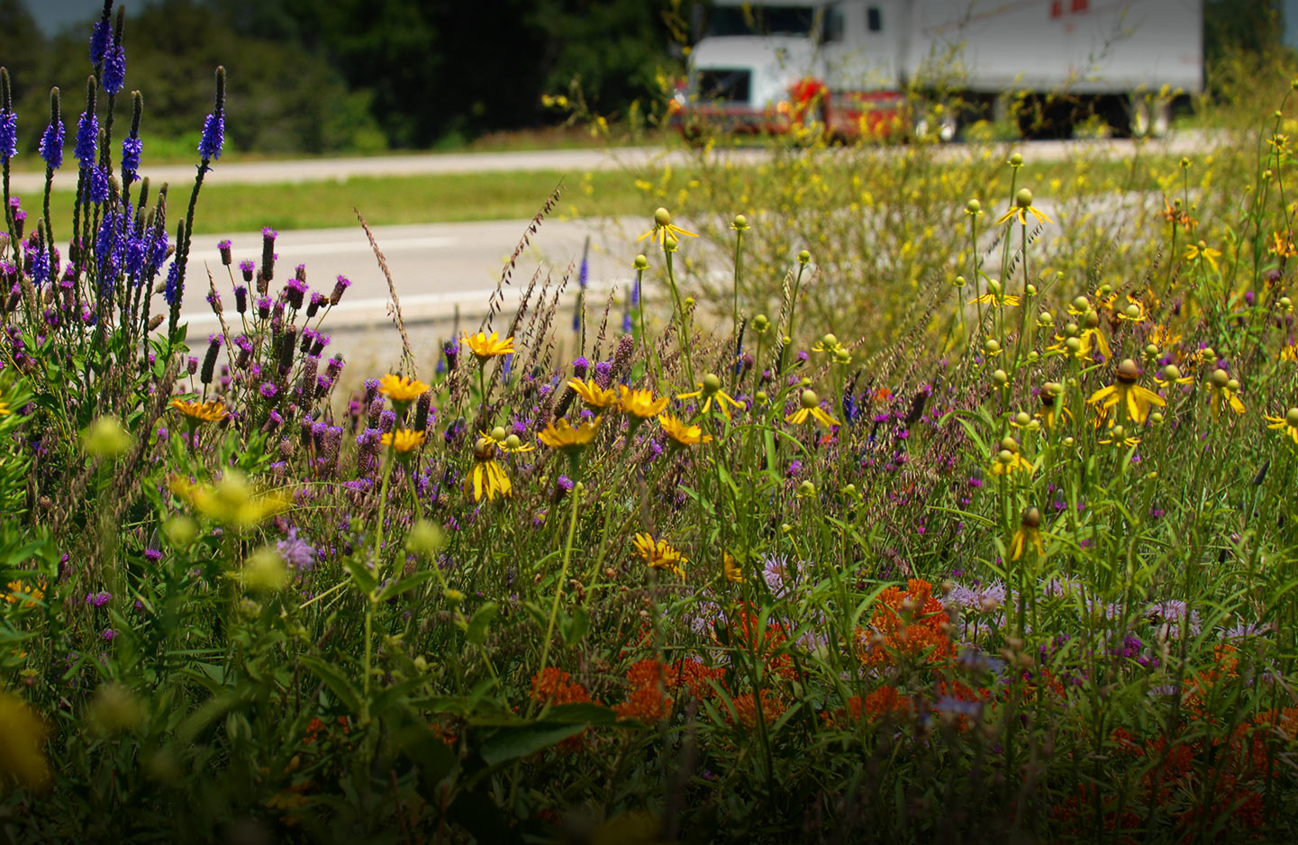
Questions?

